Slide 1

POWER UP YOUR G4M3
Competencies for the 21st century.
Dr. Gelly Aroni
Head of the Unit for Integration and Support of UAMs | Special Secretariat for the Protection of Unaccompanied Minors, Ministry of Migration and Asylum

Slide 2
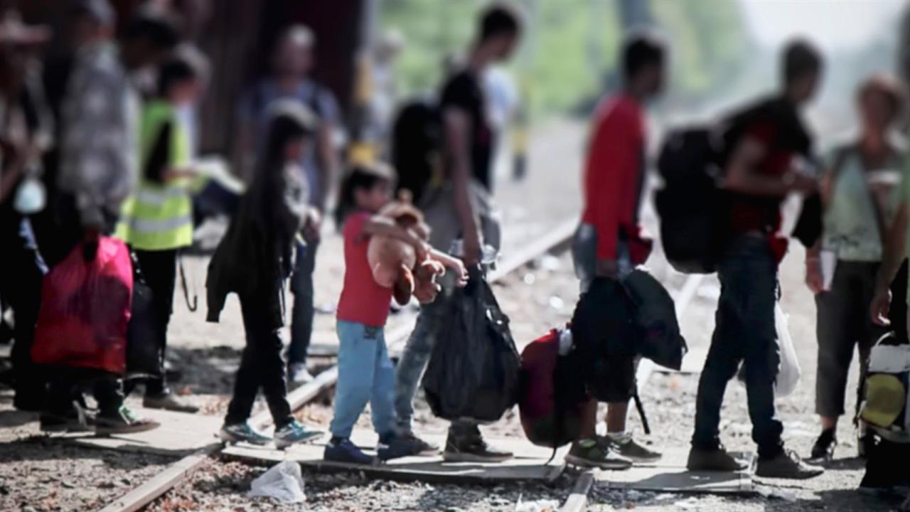

Slide 3
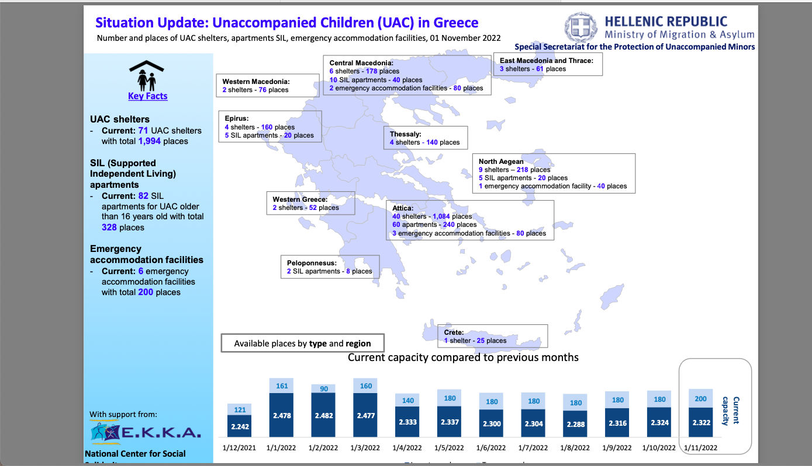

Slide 4


Slide 5
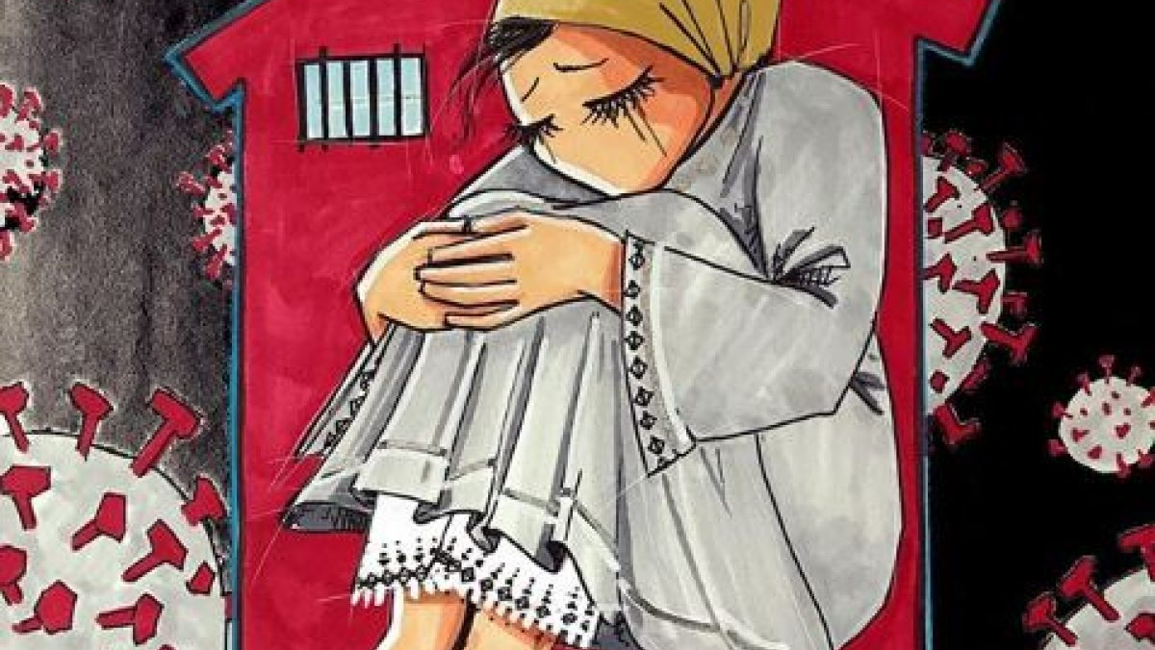

Slide 6
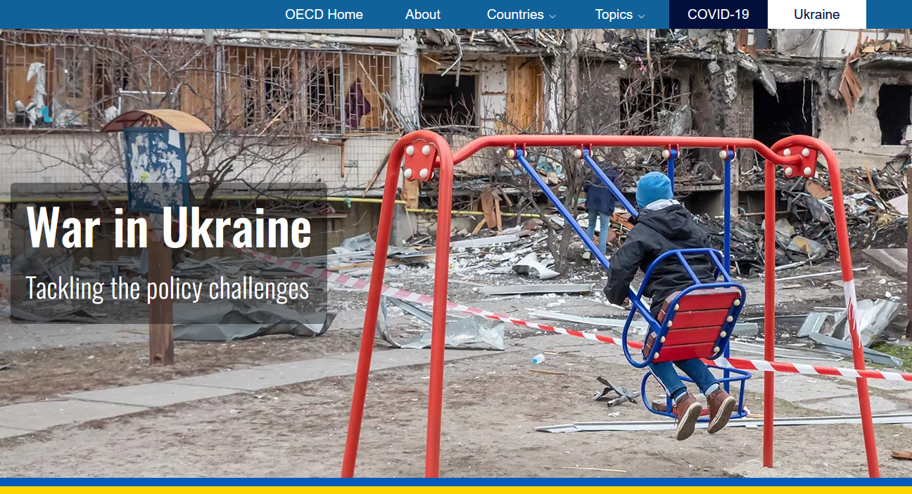

Slide 7

By one popular estimate, 65% of children entering primary school today will ultimately end up working in completely new job types that don’t yet exist. McLeod, Scott and Fisch, Karl “Shift Happens”

Slide 8

How do we prepare youth for a future we don’t know?

Slide 9
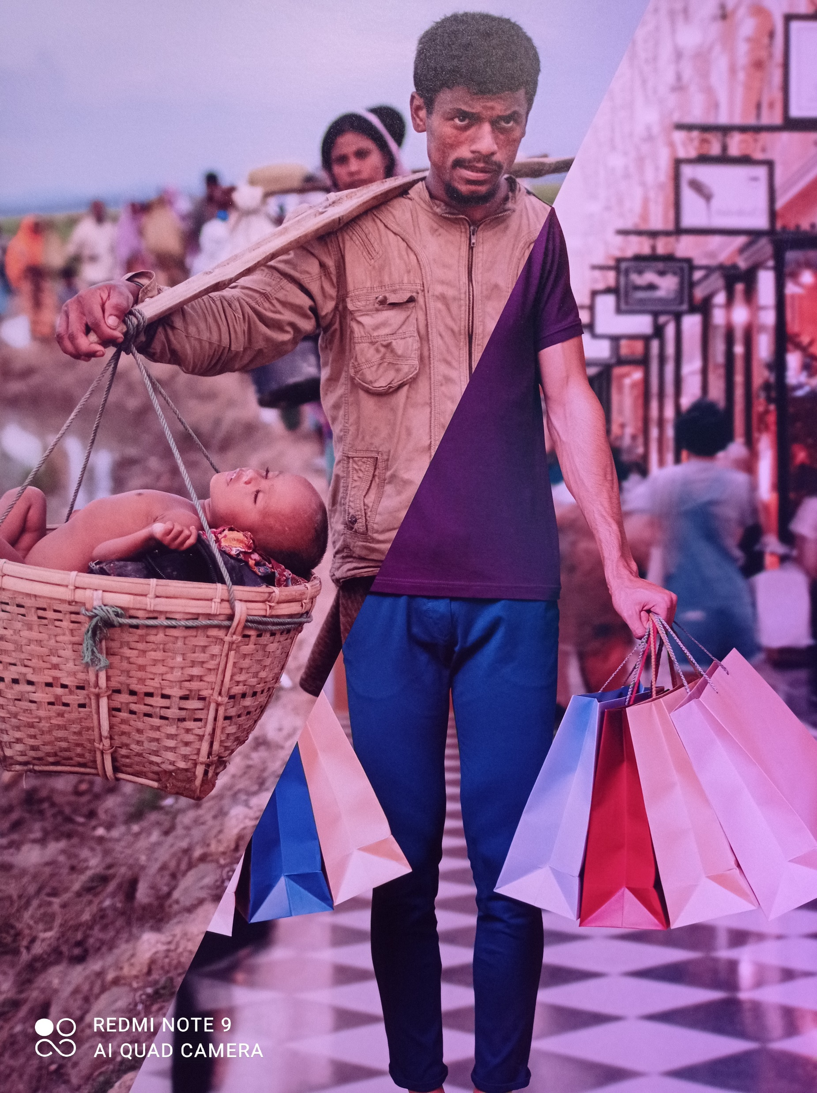
Challenges your generation faces:
Conflicts and wars
World-wide pandemics
Environmental damage
Migration and mobility
Citizen dissatisfaction
Increasing inequality of wealth
Changing norms in society
Constant technological developments

Slide 10
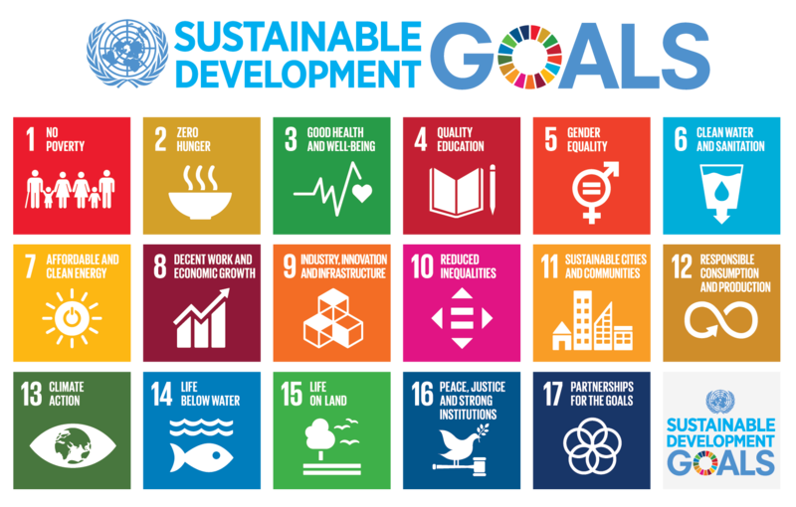
Agenda 2030 of the UN for sustainability

Slide 11

Twelve 21st century skills: https://oecdedutoday.com/what-should-students-learn-in-the-21st-century/
21st Century skills are 12 abilities that today’s students need to succeed in their lives: Creativity, Critical thinking, Collaboration, Communication,
Information literacy, Media literacy, Technology literacy, Flexibility, Leadership, Initiative, Productivity, Social skills

Slide 12

Knowledge – relevance required: Students’ lack of motivation, and often disengagement, reflects the inability of education systems to connect content to real-world experience.
Skills – Higher-order skills (“21st Century Skills”), essential for absorbing knowledge as well as for work performance.
“Character” (behaviors, attitudes, values) –As complexities increase, humankind is rediscovering the importance of character traits, such as performance-related traits (adaptability, persistence, resilience) and moral-related traits (integrity, justice, empathy, ethics).

Slide 13
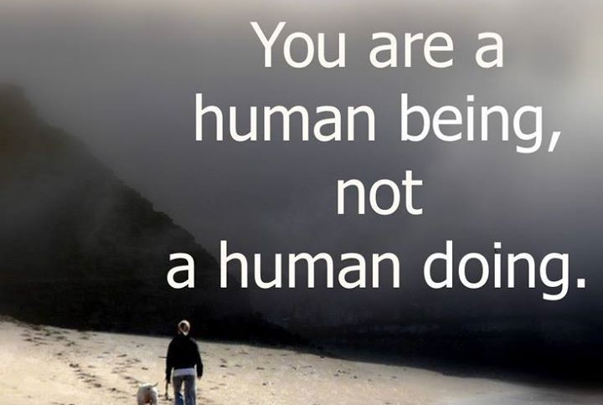

Slide 14
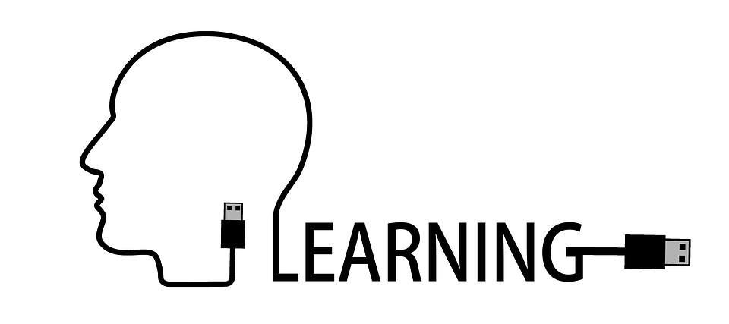
The meta-layer/fourth dimension
Learning how to learn, interdisciplinarity, and personalisation.
Essential for achieving effective learning, activating transference, building expertise, fostering creativity via analogies, establishing lifelong learning habits.

Slide 15
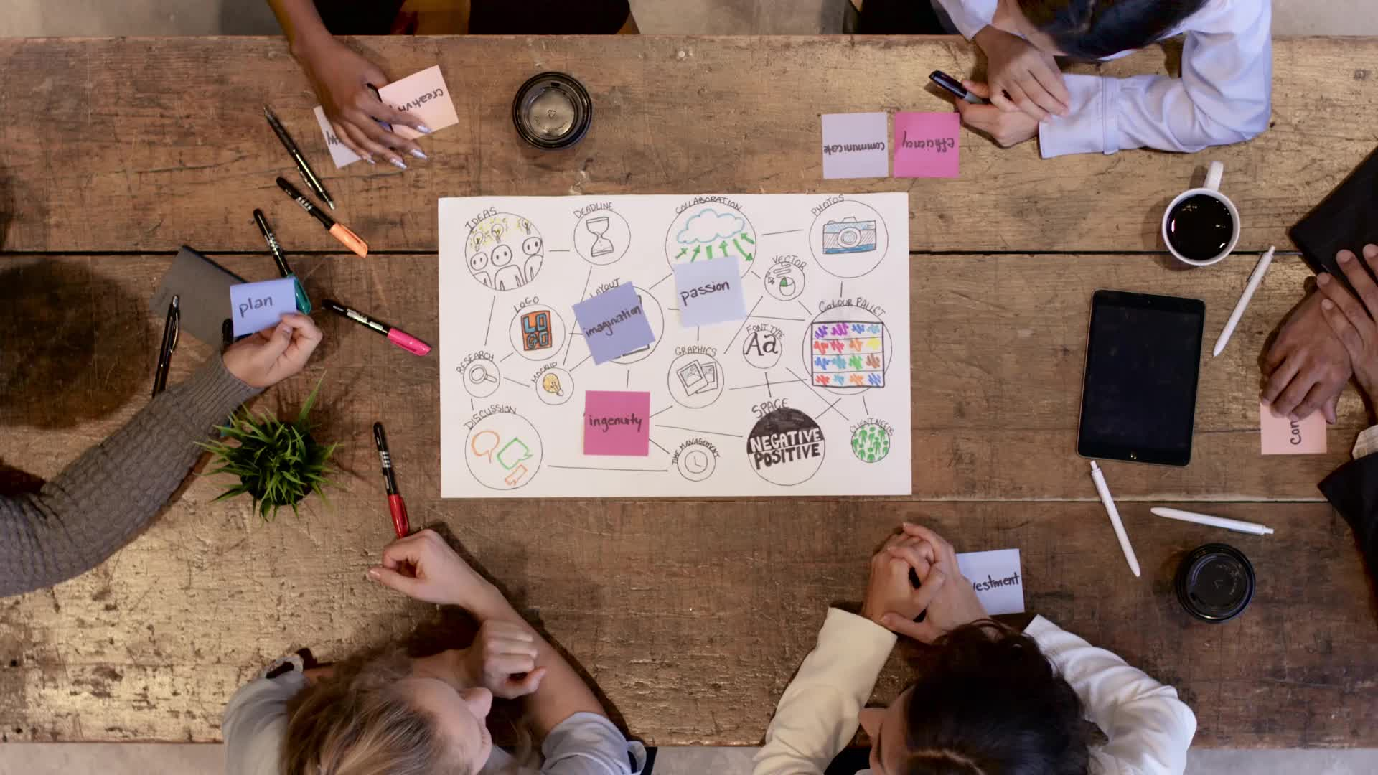
21st Century skills are competences needed to succeed in life:
4 of those are very core!!

Slide 16
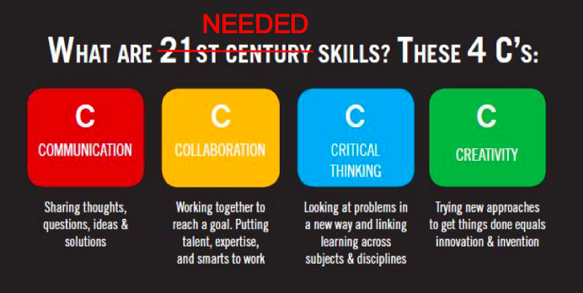

Slide 17
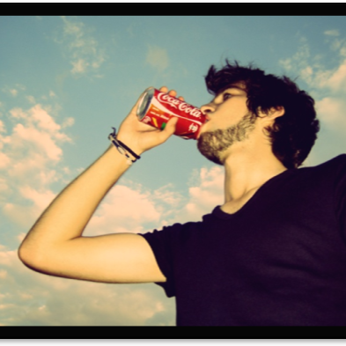
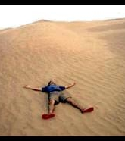
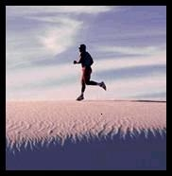

Slide 18
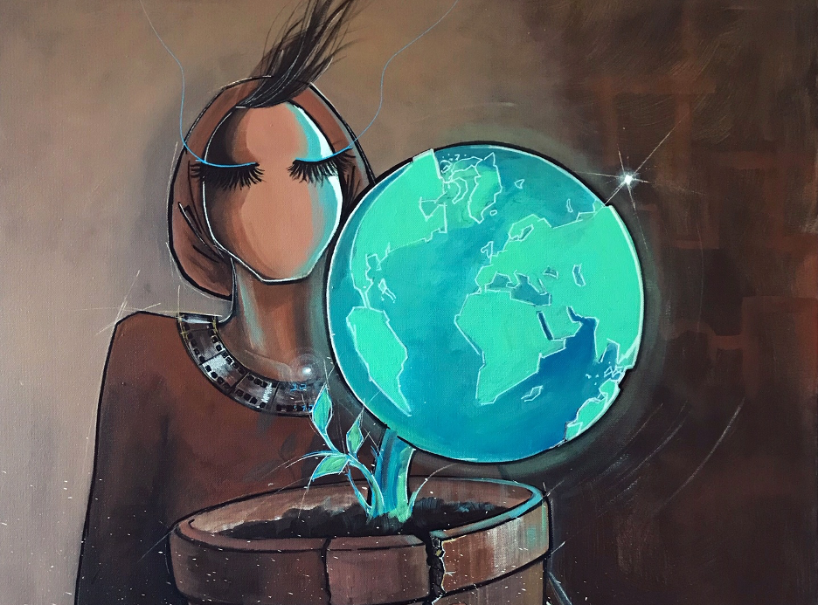
Thank you

Slide 19
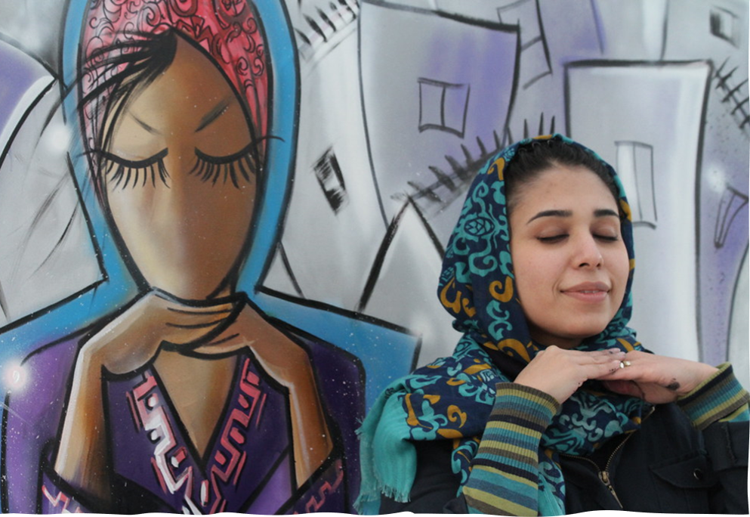
Born April 1988, Shamsia Hassani, is the first female graffiti artist of Afghanistan. Through her artworks, Shamsia portrays Afghan women in a male dominant society.

Slide 20

"The only constant in life is change."
Heraclitus

