Slide 1
game changer
noun
plural noun: game changers
an event, idea, or procedure that effects a significant
shift in the current way of doing or thinking about something
2) someone that can spark new concepts, inspire the
desire for, and acceptance of, change, and create the change itself
Game Changers
Notes:
Game changer def

Slide 2
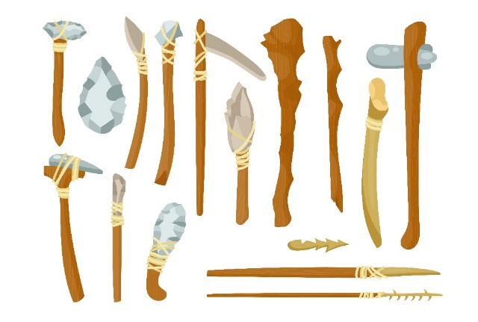
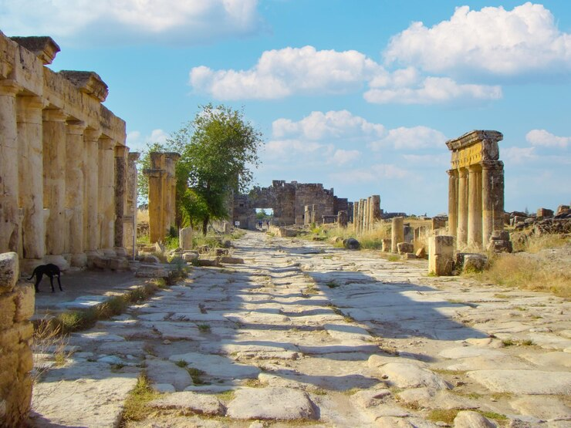
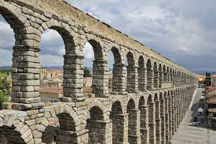
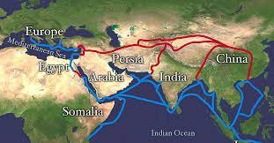
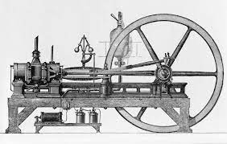
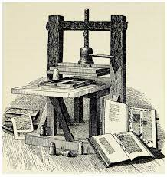
Game Changers
Notes:
Intro slide

Slide 3
Pre-Digital Methodology
face-to-face interaction snail mail telephone libraries
Game Changers: The Search Engine
Notes:
IDUAI

Slide 4
Write
Game Changers: The Search Engine
Notes:
Write

Slide 5
Write
Post
Dune
Dune
Game Changers: The Search Engine
Notes:
Post

Slide 6
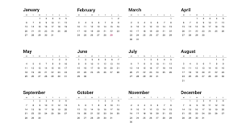
Write
Post
Wait
Dune
Game Changers: The Search Engine
Notes:
Wait

Slide 7
Write
Post
Wait
Call
Dune
Game Changers: The Search Engine
Notes:
Call

Slide 8
Write
Post
Wait
Call
Travel
Dune
Game Changers: The Search Engine
Notes:
Travel

Slide 9
IMPRESSIVE AMOUNT OF DATA Pages and pages of useful critical analysis. Pages and pages of useful critical analysis. Pages and pages of useful critical analysis. Pages and pages of useful critical analysis. Pages and pages of useful critical analysis. Pages and pages of useful critical analysis. Pages and pages of useful critical analysis. Pages and pages of useful critical analysis. Pages and pages of useful critical analysis. Pages and pages of useful critical analysis. Pages and pages of useful critical analysis. Pages and pages of useful critical analysis. Pages and pages of useful critical analysis. Pages and pages of useful critical analysis. Pages and pages of useful critical analysis. Pages and pages of useful critical analysis.
Pages and pages of useful critical analysis. Pages and pages of useful critical analysis. Pages and pages of useful critical analysis. Pages and pages of useful critical analysis. Pages and pages of useful critical analysis. Pages and pages of useful critical
Expected Result
Actual Result
Dune
NOT EVEN ONE PAGE OF USEFUL DATA
Outrageous waste of time effort and money. Outrageous waste of time effort and money. Outrageous waste of time effort and money. Outrageous waste of
time effort and money. Outrageous waste of time effort
and money. Outrageous waste of time effort and money.
Outrageous waste of time effort and money. Outrageous waste of time effort and money. Outrageous waste of time effort and money. Outrageous waste of
time effort and money. Outrageous waste of time effort
and money. Outrageous waste of time effort and money.
Outrageous waste of time effort and money. Outrageous waste of time effort and money. Outrageous waste of time effort and money. Outrageous waste of
time effort and money. Outrageous waste of time effort
and money. Outrageous waste of time effort and money. . Outrageous waste of time effort
and money. Outrageous waste of time effort and money.
Outrageous waste of time effort and money. Outrageous waste of time effort and money. Outrageous waste of time effort and money. Outrageous waste of
time effort and money. Outrageous waste of time effort
and money. Outrageous waste of time effort and money.
Game Changers: The Search Engine
Notes:
Thesis

Slide 10
Phew!
Game Changers: The Search Engine
Notes:
Library

Slide 11
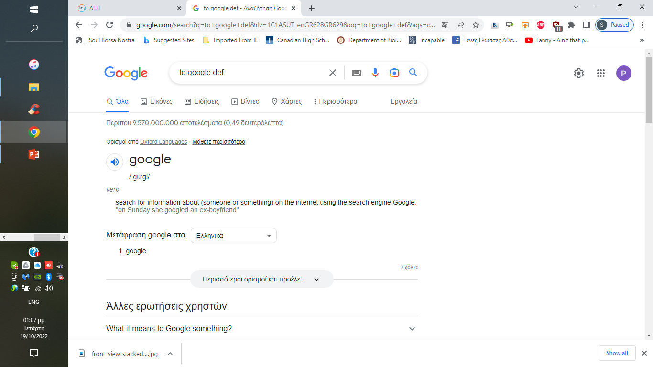
_________________________
Access to information “is an integral part of the right to freedom of mmmmmmexpression”mmmmmmmmmmmmmmmmmmmm and “a key enabler towards inclusive knowledge societies.”
Image credit: UNESCO, CC BY-SA 3.0 IGO
Game Changers: The Search Engine

Slide 12
28th September
International Day for Universal Access to Information (IDUAI)
Game Changers: The Search Engine
Notes:
IDUAI

Slide 13
Access to information is “an integral part of the right to freedom of expression” and “a key enabler towards inclusive knowledge societies.”
Moez Chakchouk,
Assistant Director-General for Communication and Information
UNESCO
Game Changers: The Search Engine
Notes:
IDUAI 2

Slide 14
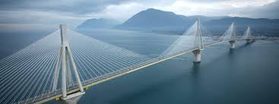
Images:
wirestock, upklyak, pch.vector, macrovector, vectorjuice,
rawpixel.com, pikisuperstar, tonodiaz on Freepik
UNESCO, CC BY-SA 3.0 IGO
Sources:
https://www.timetoast.com/timelines/history-of-the-world-through-invention-and-expansion
https://www.unesco.org/en/days/universal-access-information
Game Changers
Notes:
Outro slide/Sources

