Slide 1
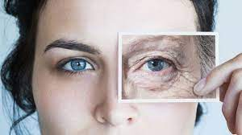
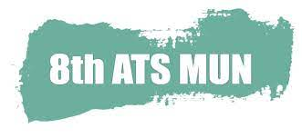
The environments we grow up in impact on our attitudes
Age determines who can receive certain medical procedures or treatments
Older adults are the only stigmatized group of which we all become a part
We all love our
grandparents,
don’t we?
GA3 Social Humanitarian Committee
The Global Challenge of Ageism

Slide 2
elderly, being of advanced years, aged, aging, ancient, geriatric, long-lived, over-the-hill, senescent, pensioned, retired, superannuated, decrepit, doddering, senile,
tottery, overaged, long in the tooth, of a certain age
GA3 Social Humanitarian Committee
The Global Challenge of Ageism
Image by cookie studio</a> on Freepik

Slide 3
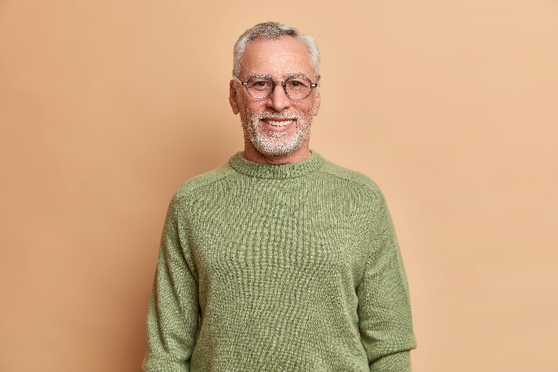
elderly, being of advanced years, aged, aging, ancient, geriatric, long-lived, over-the-hill, senescent, pensioned, retired, superannuated, decrepit, doddering, senile,
tottery, overaged, long in the tooth, of a certain age
senior, mature, venerable, ageless
GA3 Social Humanitarian Committee
The Global Challenge of Ageism
Images by wayhomestudio</a> & cookie studio</a> on Freepik

Slide 4
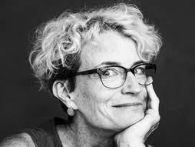
“the elderly”
“This implies a homogenous group, when nothing could be further from the case.”
Ashton Applewhite
GA3 Social Humanitarian Committee
The Global Challenge of Ageism

Slide 5
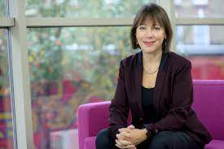
“Each time we see an older person, we need to imagine them as our future self, and rather than recoil from their wrinkles or infirmities, applaud their resilience. We need to re-humanise older people, to shift norms, expectations, policies and outcomes for all older people”.
GA3 Social Humanitarian Committee
The Global Challenge of Ageism

Slide 6
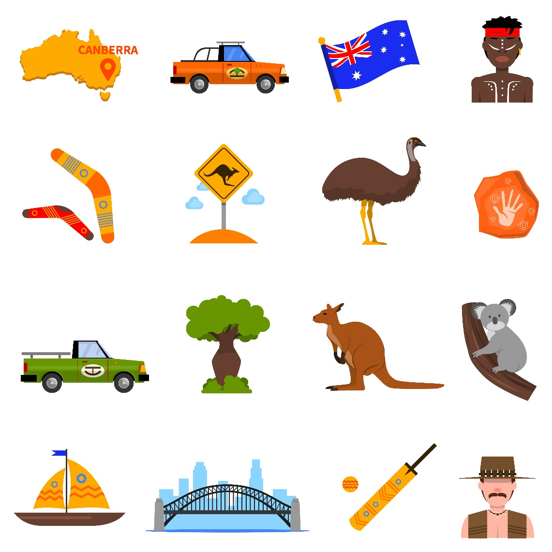
Game Changer?
GA3 Social Humanitarian Committee
The Global Challenge of Ageism
Image by macrovector</a> on Freepik

Slide 7
adolescent, immature, juvenile, preteen, puerile, minor, underage, callow, green, inexperienced, raw, babyish, childish, childlike, infantile
GA3 Social Humanitarian Committee
The Global Challenge of Ageism
Image by wayhomestudio</a on Freepik

Slide 8
adolescent, immature, juvenile, preteen, puerile, minor, underage, callow, green, inexperienced, raw, babyish, childish, childlike, infantile
youthful
GA3 Social Humanitarian Committee
The Global Challenge of Ageism
Images by wayhomestudio</a> & lookstudio</a> on Freepik

Slide 9
Sources
https://msutoday.msu.edu/news/2020/ageism
https://academic.oup.com/gerontologist/article/60/1/174/5166947
https://www.who.int/news/item/18-03-2021-ageism-is-a-global-challenge-un
https://www.theguardian.com/lifeandstyle/2018/sep/14/the-ugly-truth-about-ageism-its-a-prejudice-targeting-our-future-selves
https://www.ohchr.org/en/stories/2021/09/eliminate-ageism-and-age-discrimination-says-un-expert
GA3 Social Humanitarian Committee
The Global Challenge of Ageism

Slide 10
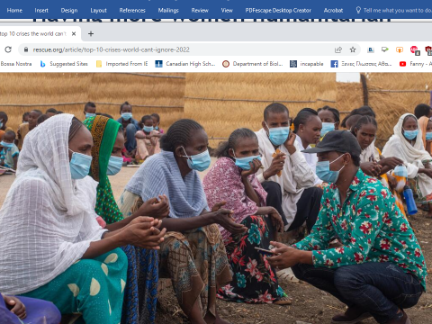
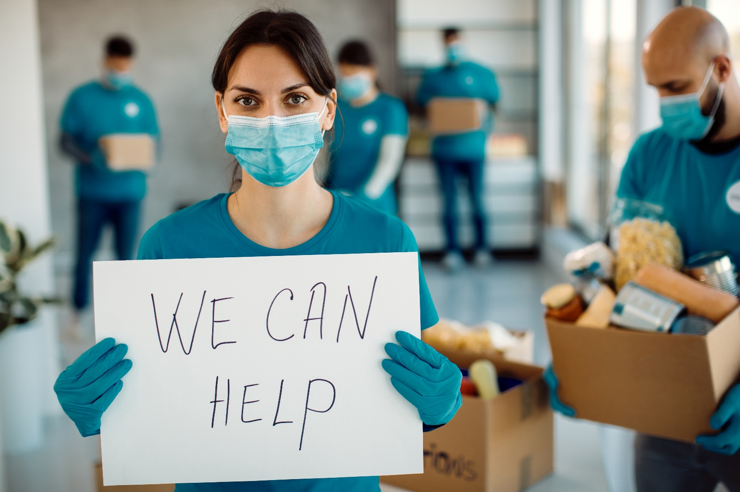
Earthquake
War
Disaster
Famine
Drought
Long Covid
importance
Image by Drazen Zigic</a> on Freepik
GA3 Social Humanitarian Committee
Women as game changers towards eradicating humanitarian crises

Slide 11
importance
uniquely!
ability to speak to women
undervalued knowledge
transformational leadership
Image by Drazen Zigic</a> on Freepik
GA3 Social Humanitarian Committee
Women as game changers towards eradicating humanitarian crises

Slide 12
barriers
political
organisational
cultural
financial
societal
Image by Freepik</a>
GA3 Social Humanitarian Committee
Women as game changers towards eradicating humanitarian crises

Slide 13
GA3 Social Humanitarian Committee
Women as game changers towards eradicating humanitarian crises

Slide 14
opportunities
GA3 Social Humanitarian Committee
Women as game changers towards eradicating humanitarian crises

Slide 15
Organisational culture across the conflict and humanitarian domain significantly hinders women pursuing leadership roles
Women are significantly under-represented in senior humanitarian leadership roles.
Patriarchal attitudes restrict women’s aspiration to becoming leaders.
Diverse and inclusive humanitarian leadership teams perform better.
More women leaders can transform the humanitarian system to better meet
the health needs of those affected by conflict and humanitarian emergencies.
Source
https://conflictandhealth.biomedcentral.com/articles/10.1186/s13031-020-00330-9
GA3 Social Humanitarian Committee
Women as game changers towards eradicating humanitarian crises

